Slide 1

Julia AI
Project Presentation

Slide 2
Topic
Predicting the Likelihood of E-Signing the Loan Based on Financial History

Slide 3
Introduction
Name: Dhruv Saini
Graphic Era Deemed To be University
Section: ML
University Roll No. : 2015241

Slide 4
Introduction to project
What is Machine Learning?
Machine Learning(ML) is a method of data analysis that automates analytical model building
It is a branch of Artificial Intelligence based on the idea that systems can learn from data, identify patterns and make decisions with being explicitly programmed

Slide 5

Use of Machine Learning
In this case, we can use machine learning techniques to create a model that can predict weather the loan will be e-signed or not based upon the financial history.

Slide 6
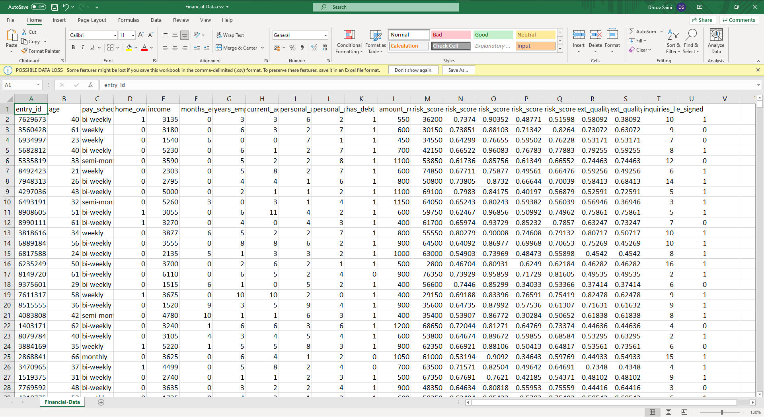
Our Dataset

Slide 7
Dataset Analysis
Our dataset comprise of :
21 different features including e-signed value.
17908 unique records of different people.
0 missing values
Two classes
e_singned 0: 8269
e_singned 1: 9639

Slide 8
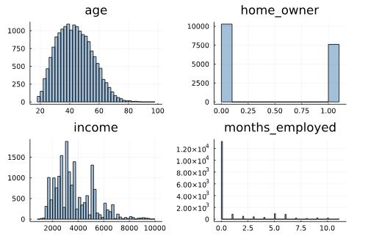
Data Visualization
It is a technique of graphically representing information and data.
To understand data better we have visualized our data into plots and histograms.

Slide 9
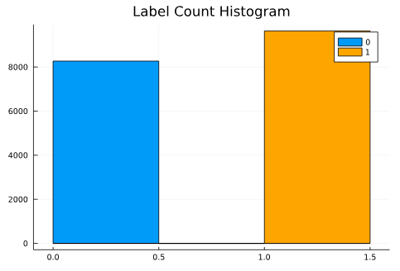
Histogram
e_singned 0: 8269
e_singned 1: 9639

Slide 10
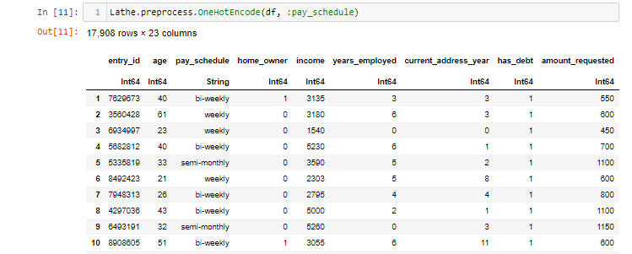
Feature Engineering
OneHotEncode
OneHotEncoding is process by which we convert categorical variable.
In this Strategy, each category value is converted into a new column and assigned a 1 or 0 value to the column.

Slide 11
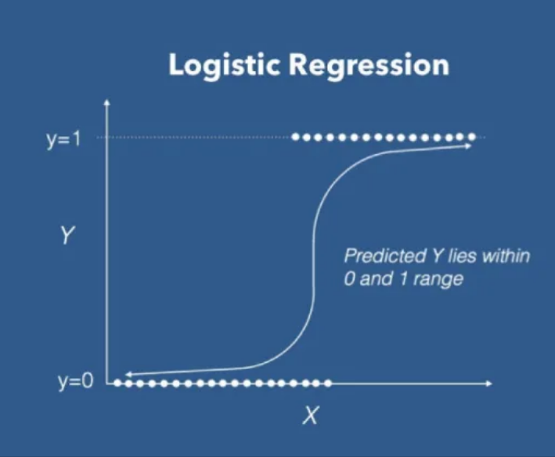
Machine Learning Model
Logistic Regression: It is a supervised machine learning classification algorithm used to predict the probability of the target variable.
It is one of the most common machine learning model used for binary classification problems.

Slide 12
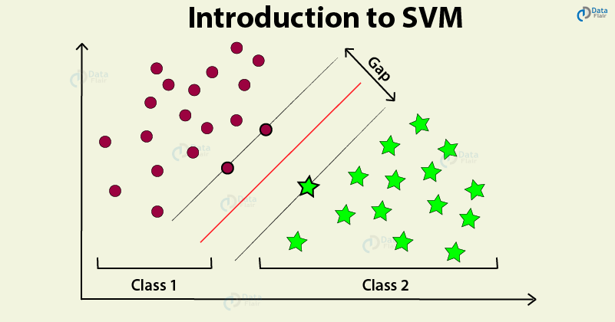
Contd.
Support Vector Machine: It is a supervised machine learning algorithm which can be used for both classification or regression challenges.
In SVM algorithm, we plot each data item as a point in n-dimensional space with the value of each feature being the value of a particular coordinate.

Slide 13
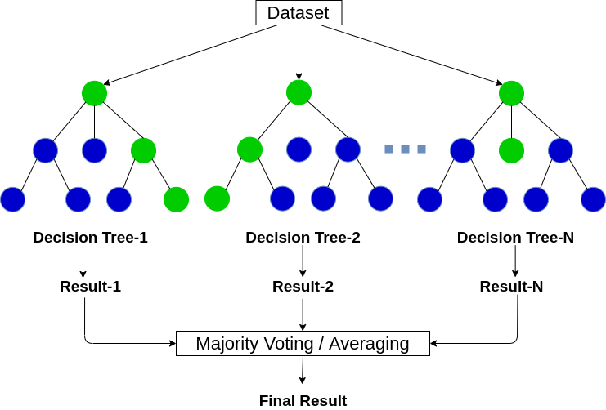
Contd.
Random Forest: It is a classification algorithm consisting of many decision trees on various subsets of the given dataset .
The greater number of trees in the forest leads to higher accuracy and prevents the problem of overfitting.

Slide 14

Training Model
The process of training a Machine Learning model involves providing an algorithm along with training data and this data contains the correct answer, which is known as a target attribute.
The learning algorithm finds patterns in the training data that map the input data attributes to the target.

Slide 15

Accuracy of model
Accuracy is one metric for evaluating classification models.
Accuracy is defined as the percentage of correct predictions for the test data.
Formula –
A = CP/TP
where,
A = Accuracy
CP = Correct Predictions
TP = Total Predictions

Slide 16
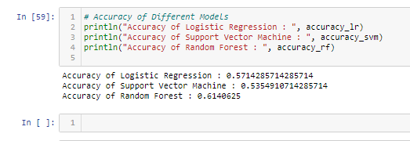
Model Result
Logistic Regression –
Accuracy: 57.14%
Support Vector Machine–
Accuracy: 53.54%
Random Forest–
Accuracy: 61.40%

Slide 17

Conclusion
In conclusion, Machine Learning is rapidly growing field in computer science. It has applications in nearly every other field of study and it is already being implemented.

Slide 18


Thank You.

